Slide 1
Defensive Security Project
Clarissa Martinez
Tina Vuong
Salina Campos

Slide 2
Table of Contents
This document contains the following resources:
Monitoring Environment
Attack Analysis
Project Summary & Future Mitigations

Slide 3

Monitoring Environment
‹#›

Slide 4
Scenario
For this project are given the role of a SOC analyst at VSI (Virtual Space Industries). The VSI company specializes in virtual reality programs and rumor is that Jobe Corp may launch a cyber attack to disrupt VSI’s business. Using Splunk we will monitor against potential attacks that might occur within our systems
The VSI products that will be used to monitor include:
An administrative webpage: https://vsi-corporation.azurewebsites.net/
Apache web server
Windows operating system (runs many of VSI's back-end operations)

Slide 5
[“Add-On” App]
‹#›

Slide 6
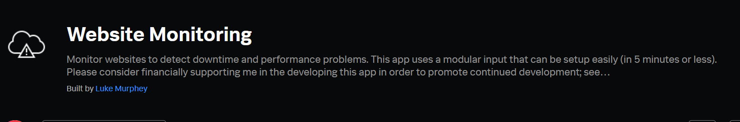
[Add-On App Name]

Slide 7
Website Monitoring (Add-On App)
Benefits of using the Website Monitoring add-on:
-know if website is functioning properly
-malware control
-minimizing the loss of clients and revenue
-continuous discovery and improvement
-optimized website performance
-organizing the company’s technological resources such as bandwidth, access to servers, use of RAM memory, and system speed

Slide 8
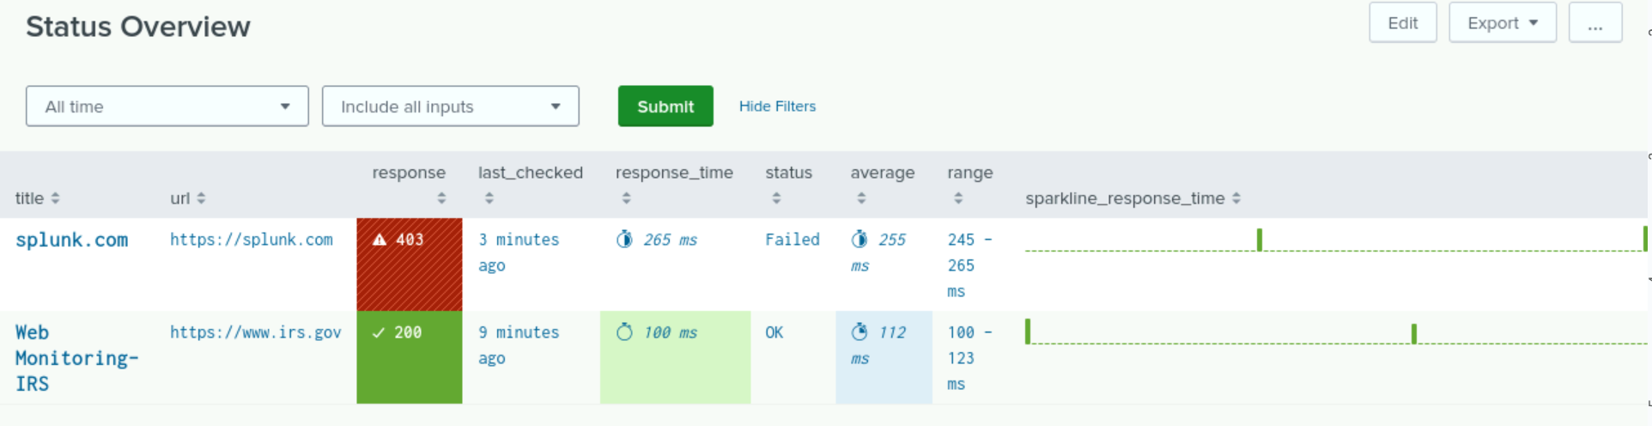
[Add-On App Name]
We monitored 2 sites, splunk.com and irs.gov.
Splunk.com seems to return a 403 error code every ping, meaning that the server recognizes our request but denies it.
IRS.gov is responding as normal.

Slide 9
Logs Analyzed
Windows Logs
Apache Logs
1
2
The Windows logs contain data involving the dates, times, users and how those users gained access into the web servers.
The set of Apache logs come from the Apache web servers that host VSI’s web application. The logs demonstrate normal business operations within the company.

Slide 10
Windows
‹#›

Slide 11
Reports
Report Name | Report Description
Users | A table of users, the count of their usage and the percentage of usage.
Success & Failure of Windows Activities | A comparison between the success and failure of Windows activities. This will show VSI if there is a suspicious level of failed activities on their server.
Severity Levels | Displays the severity levels, the count, and the percentage of each.
Signatures & Associated Signature IDs | A table of signatures and associated signature IDs.

Slide 12
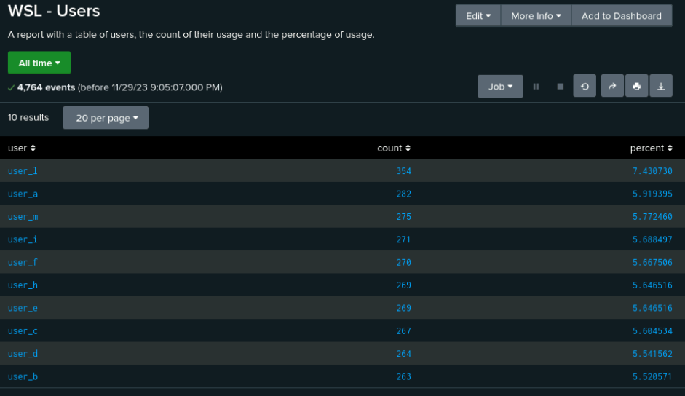
Images of Reports—Windows

Slide 13
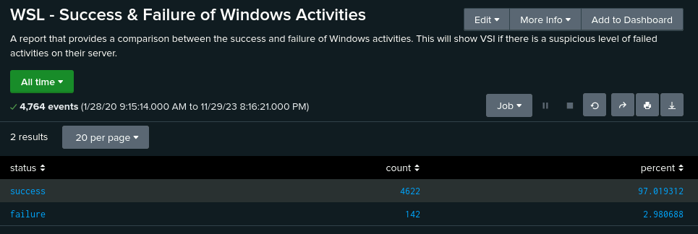
Images of Reports—Windows

Slide 14
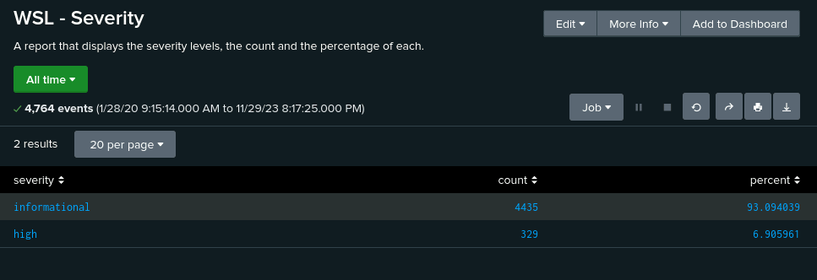
Images of Reports—Windows

Slide 15
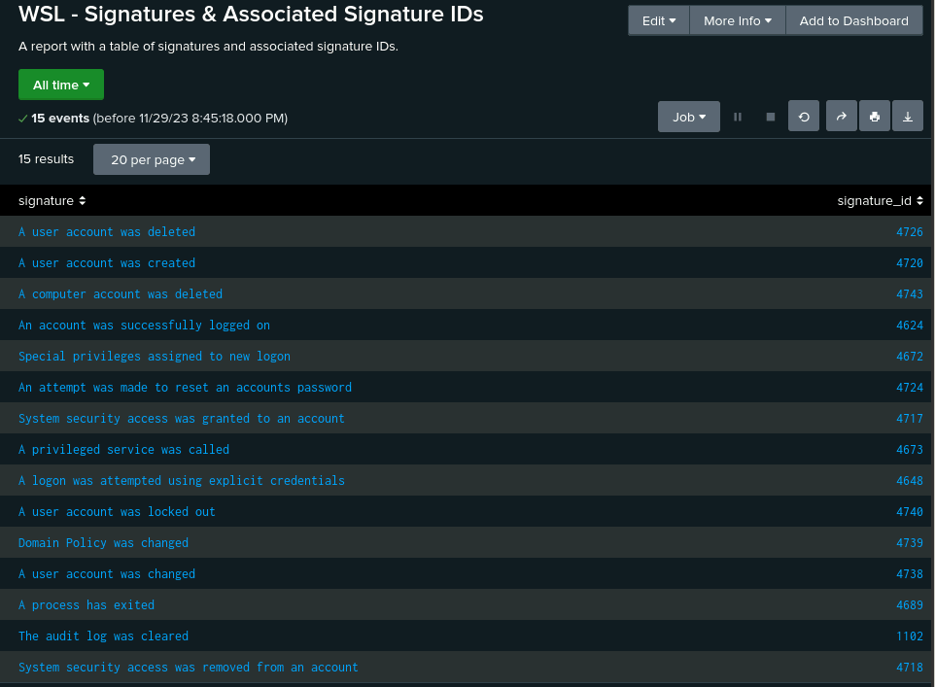
Images of Reports—Windows

Slide 16
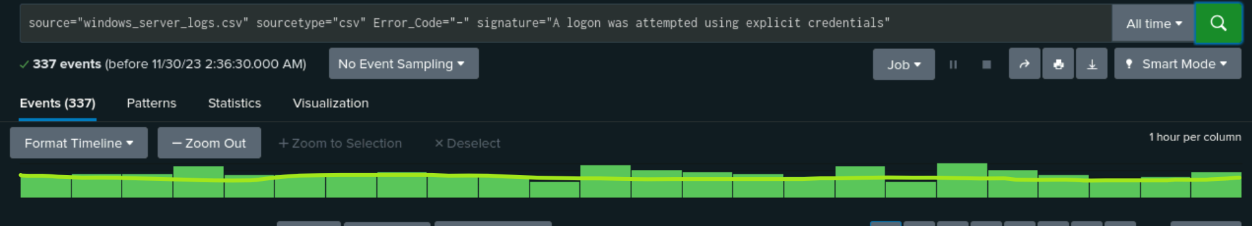
Alerts—Windows
Designed the following alerts:
Alert Name | Alert Description | Alert Baseline | Alert Threshold
Failed Windows Activity | Splunk alerts VSI when the amount of failed windows activity breaches the threshold. | 14 | 15
JUSTIFICATION:

Slide 17
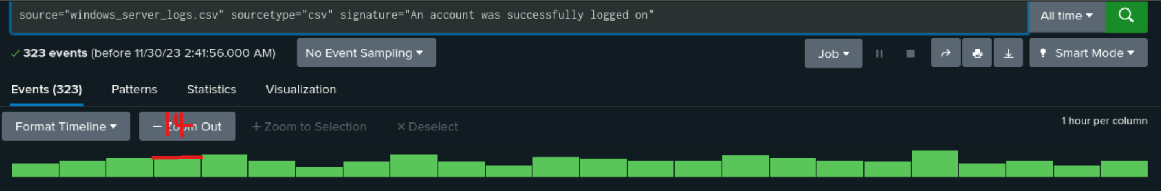
Alerts—Windows
Designed the following alerts:
Alert Name | Alert Description | Alert Baseline | Alert Threshold
Successful Log In Attempt Threshold | Splunk alerts VSI when the amount of log ins breaches the threshold. | 14 | 15
JUSTIFICATION:

Slide 18
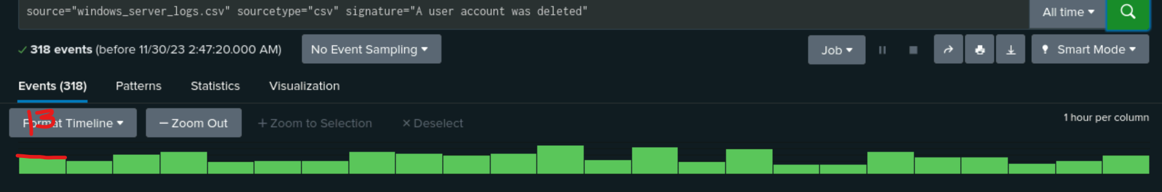
Alerts—Windows
Designed the following alerts:
Alert Name | Alert Description | Alert Baseline | Alert Threshold
Accounts Deleted Threshold | Alert that notifies VSI when an abnormal amount of deleted accounts has occurred. | 12 | 13
JUSTIFICATION:

Slide 19
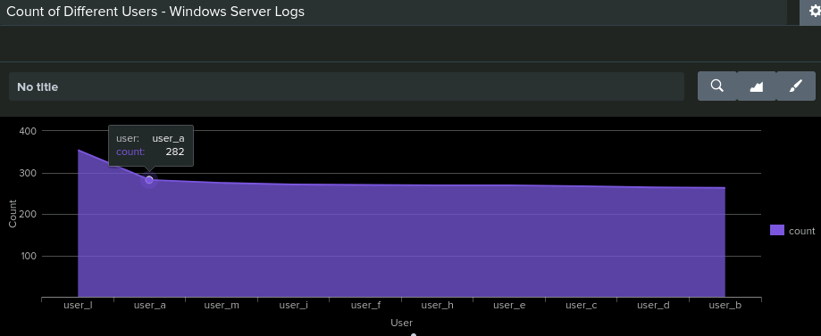
Dashboards—Windows

Slide 20
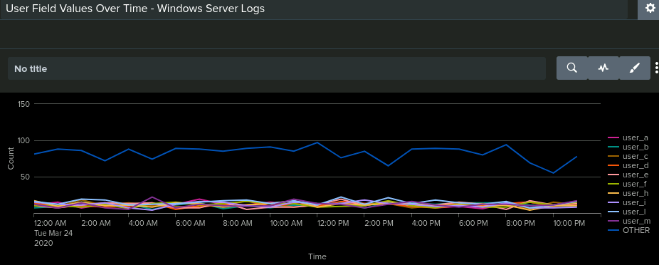
Dashboards—Windows

Slide 21
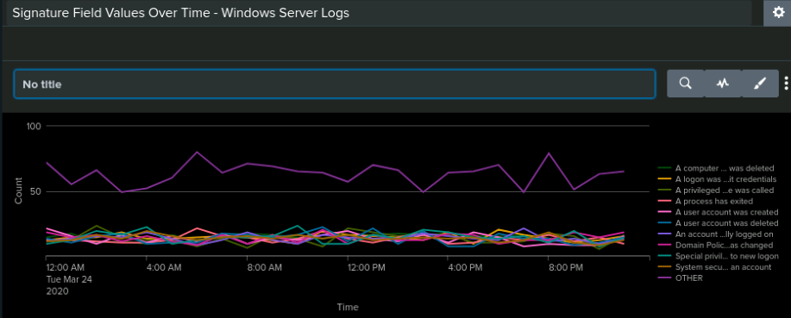
Dashboards—Windows

Slide 22
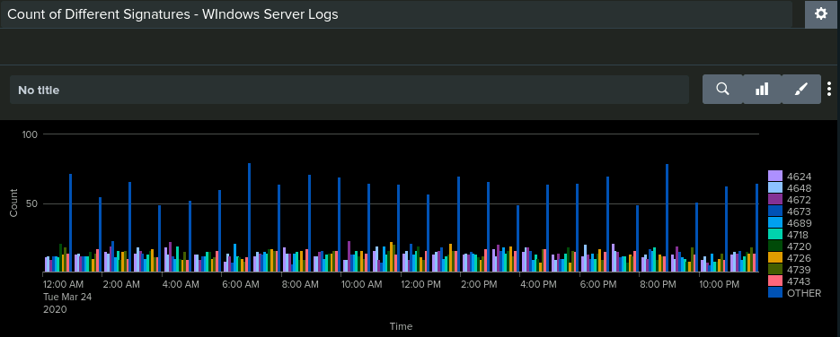
Dashboards—Windows

Slide 23
Apache Logs
‹#›

Slide 24
Reports—Apache
Designed the following reports:
Report Name | Report Description
HTTP Methods | A report of different HTTP Methods (GET, POST, HEAD, etc). Provides insight to the type of HTTP activity that is requested against the VSI’s web server.
Top 10 Referred Domains | A report showing the top 10 domains that refer to VSI’s website
HTTP Response Code | A report showing the count of each HTTP response code

Slide 25
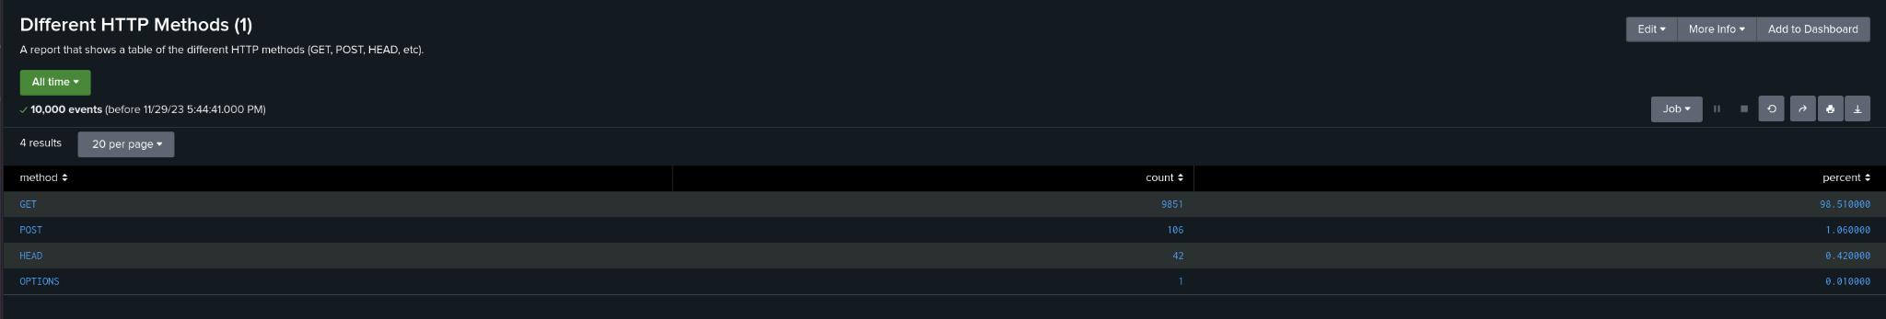
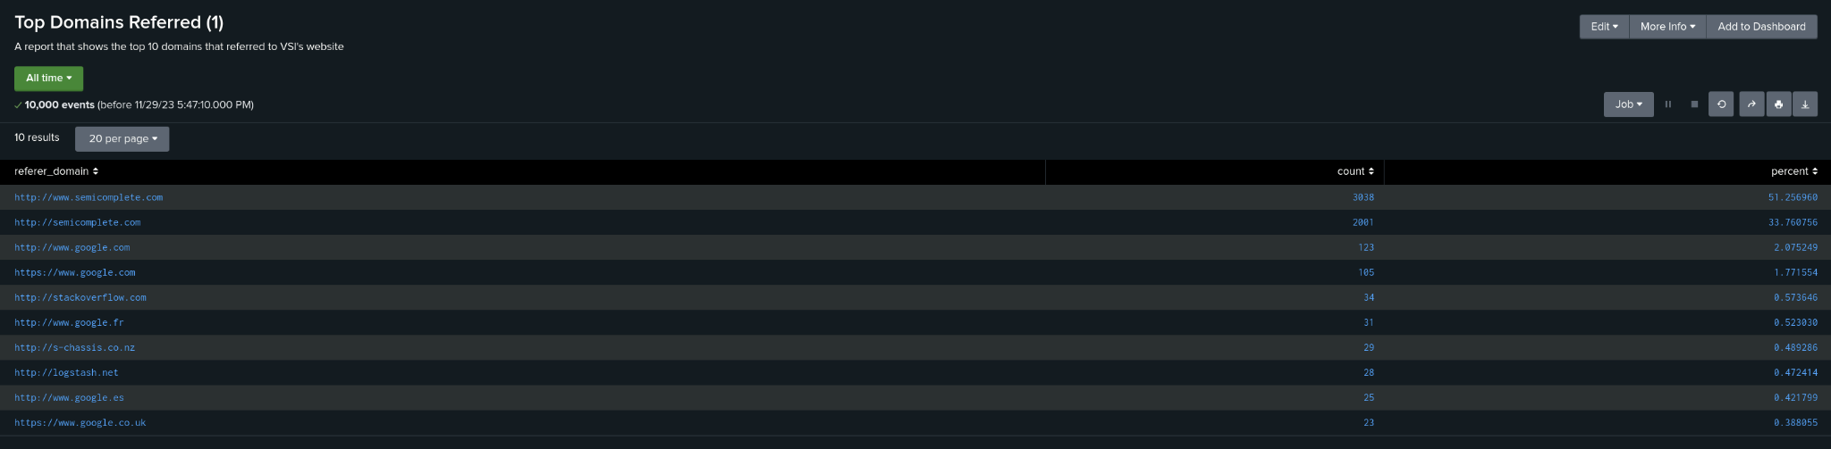
Images of Reports—Apache
Report Image
Report Image
Report Image
Report Image

Slide 26
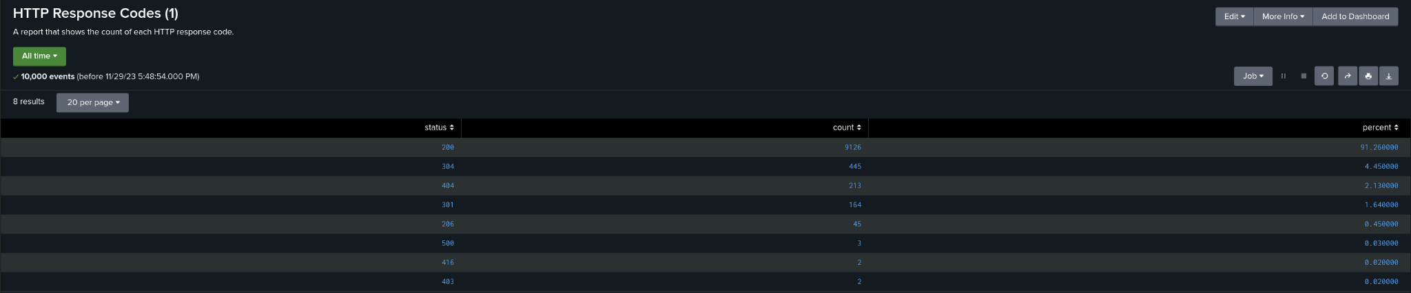
Images of Reports—Apache
Report Image
Report Image
Report Image
Report Image

Slide 27
Alerts—Apache
Designed the following alerts:
Alert Name | Alert Description | Alert Baseline | Alert Threshold
Non-US Activity (Hourly) | The hourly activity from any country besides the United States | 90 | 100
JUSTIFICATION: The standard number of logs per hour always seemed to range between 70-90. However a few events exceeded over 100 with the most number of events showing 120. Seeing a greater number of events from the threshold should be checked on.

Slide 28
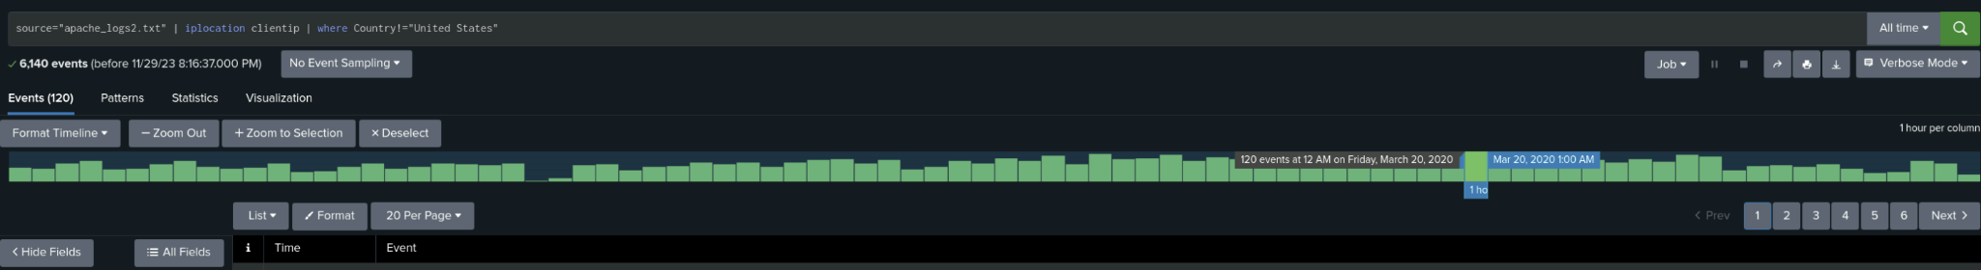
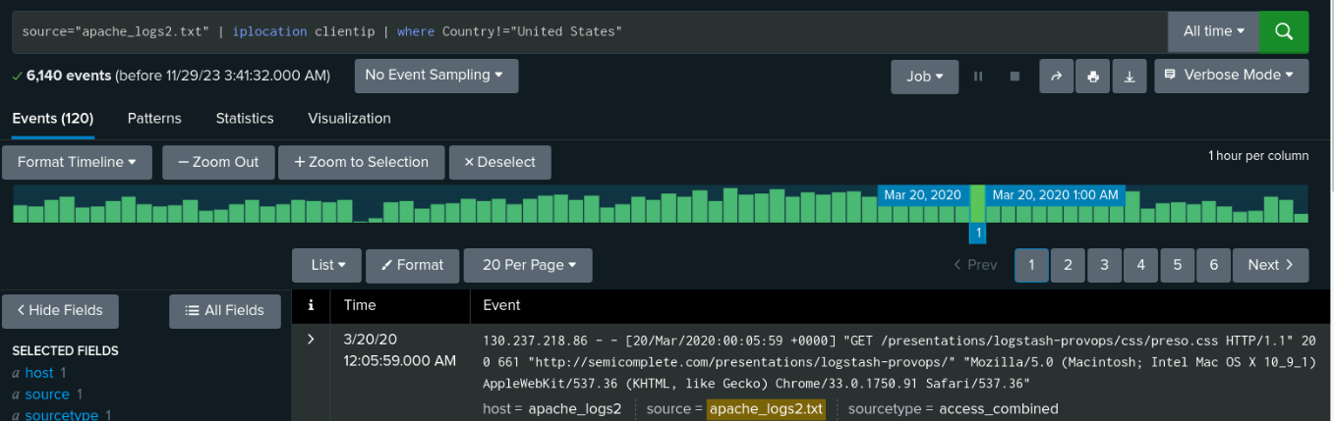
Alerts—Apache (Non-US Activity Hourly) Image

Slide 29
Alerts—Apache
Designed the following alerts:
Alert Name | Alert Description | Alert Baseline | Alert Threshold
HTTP Post Activity | The hourly count of the HTTP POST method. Baseline and threshold set as shown. | 2 | 6
JUSTIFICATION: Most events ranged at a low count of 2-5. Having a threshold of 6 should show any indication that there might be an attack occurring since the events never seemed to pass higher than 7 events.

Slide 30
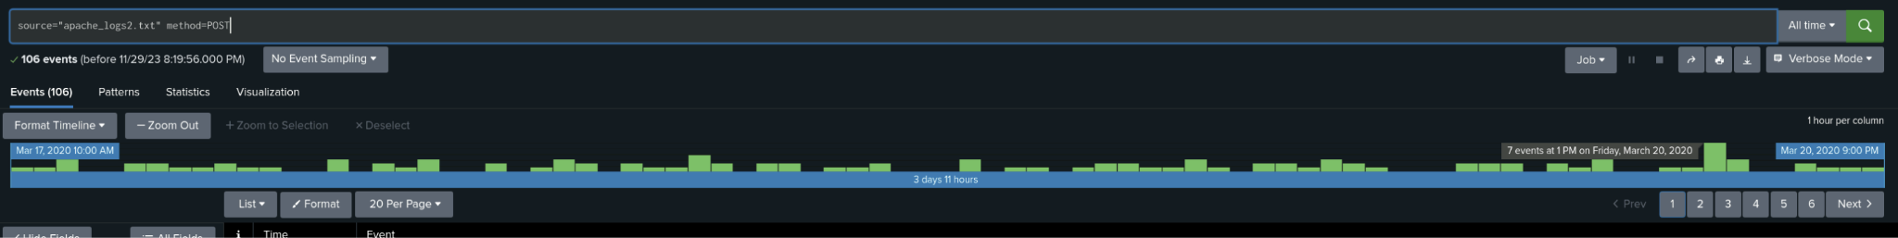
Alerts—Apache ( HTTP POST Activity) Image

Slide 31
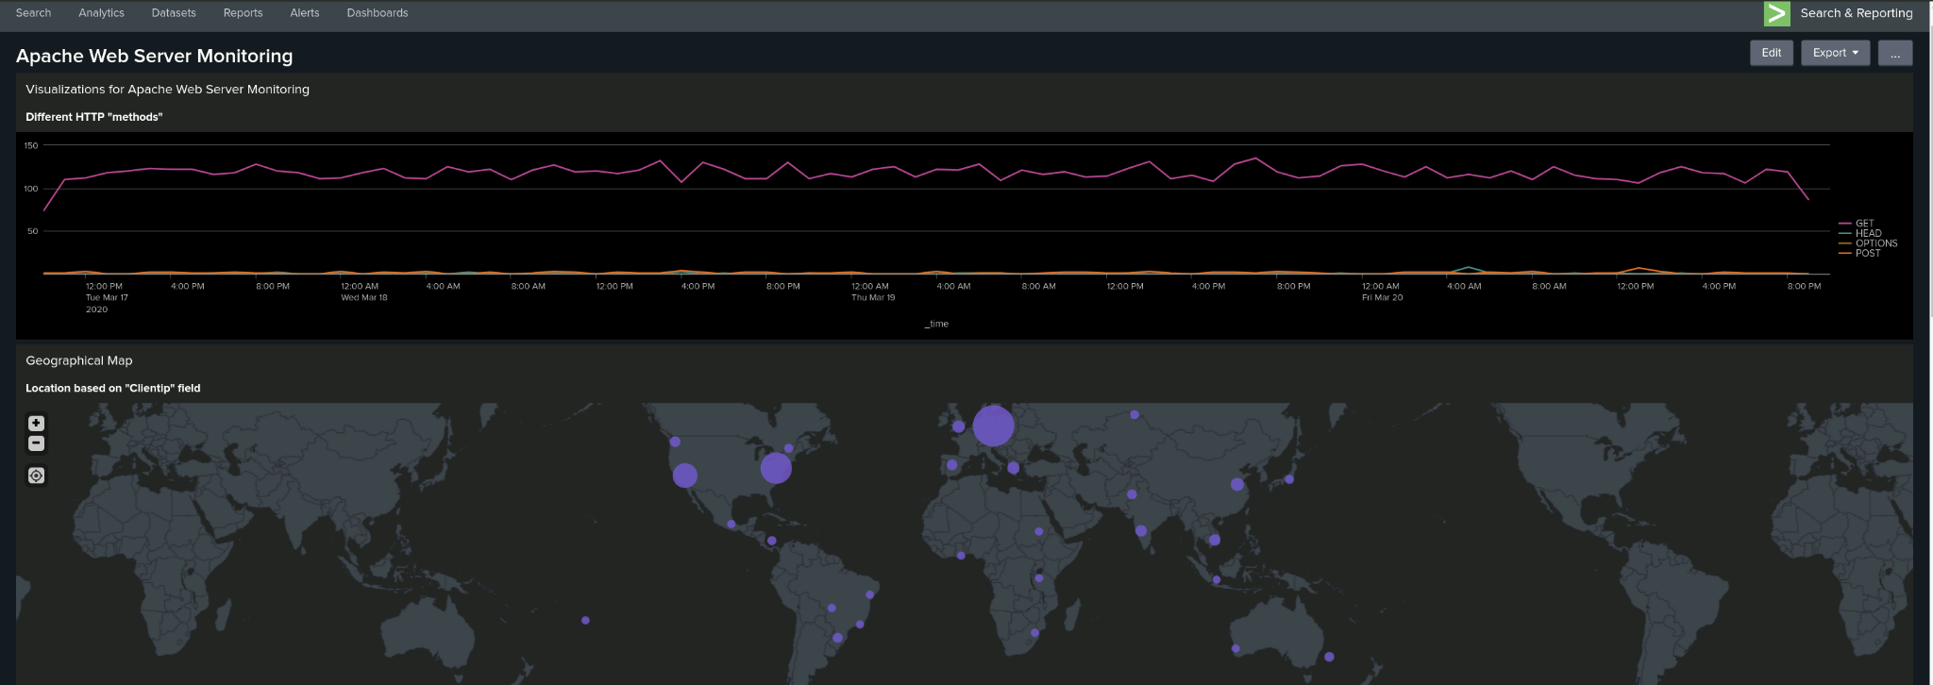
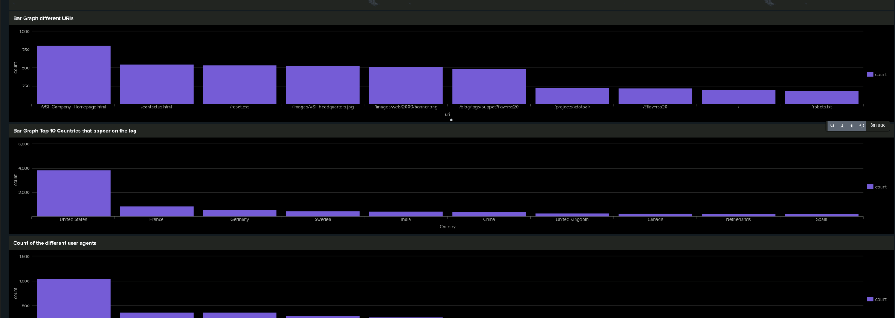
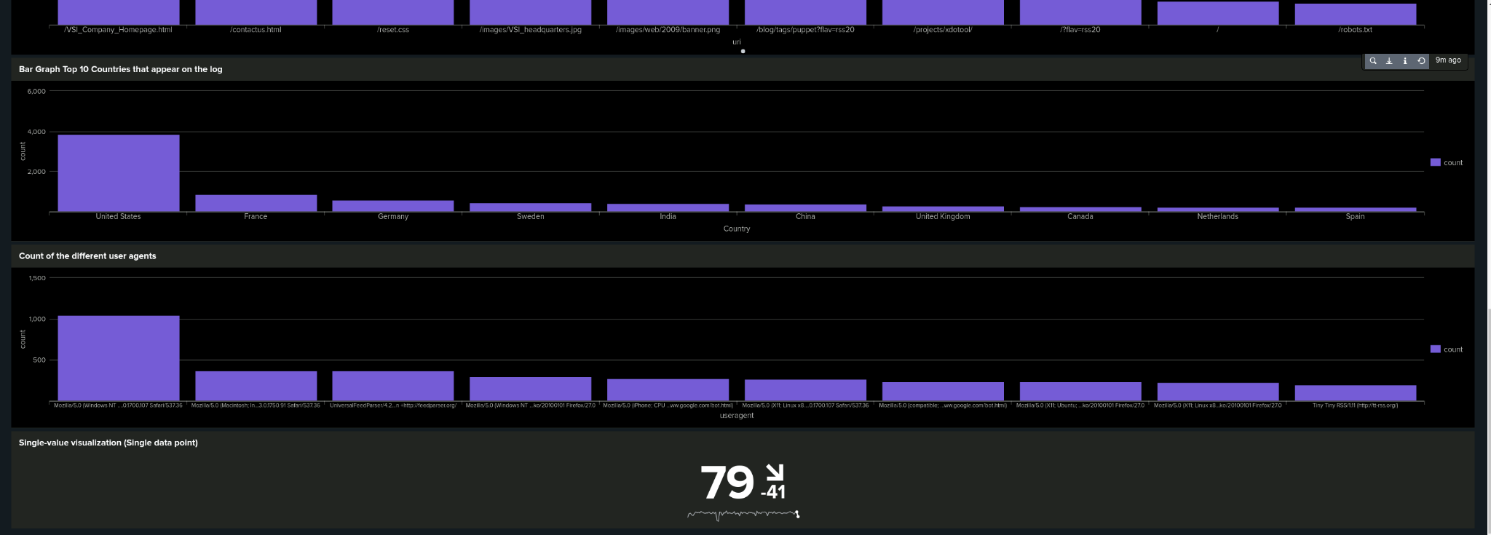
Dashboards—Apache
Place image here
Place image here
Place image here
Place image here

Slide 32
Attack Analysis
‹#›

Slide 33
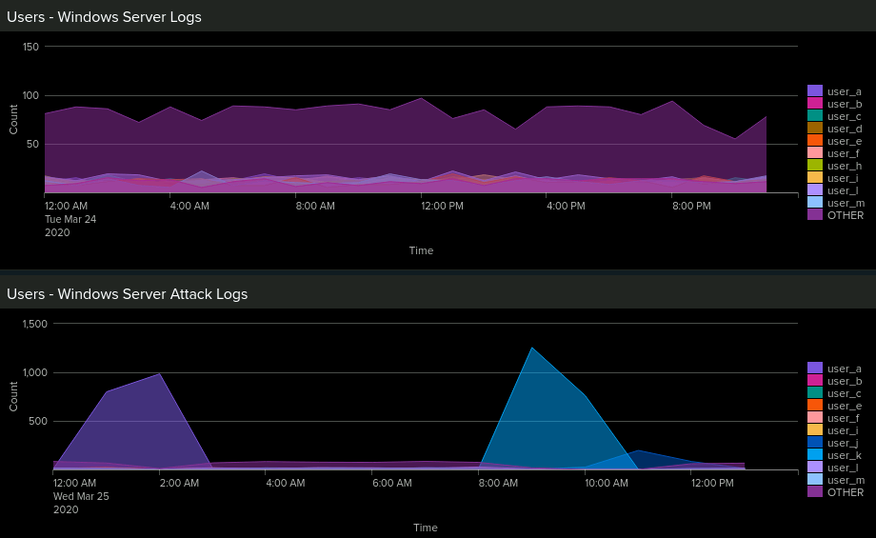
Dashboards—Attack Logs

Slide 34
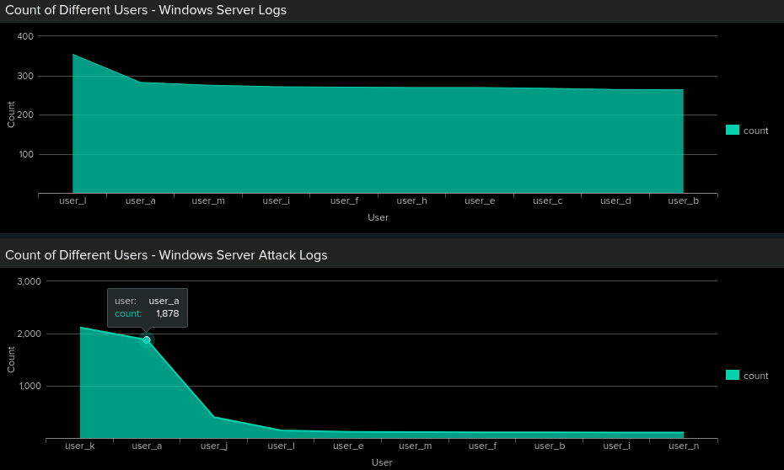
Dashboards—Attack Logs

Slide 35
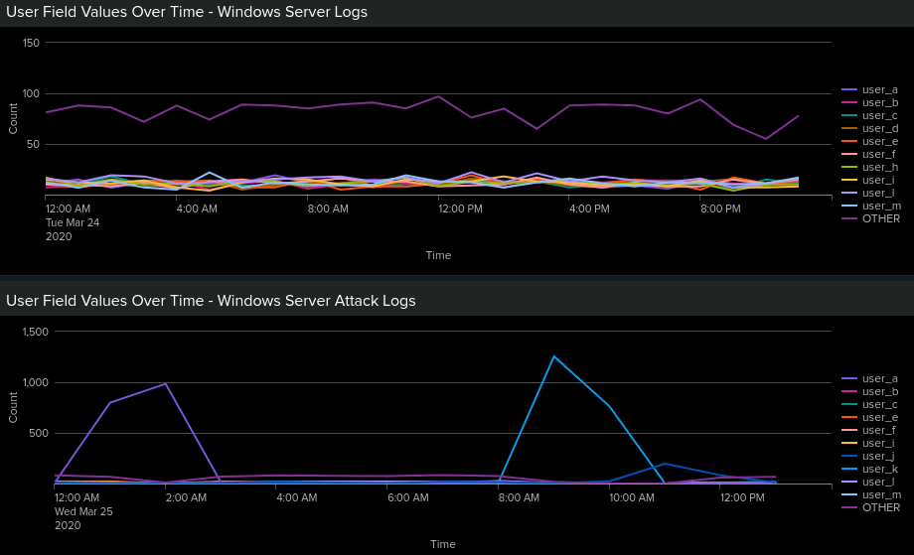
Dashboards—Attack Logs

Slide 36
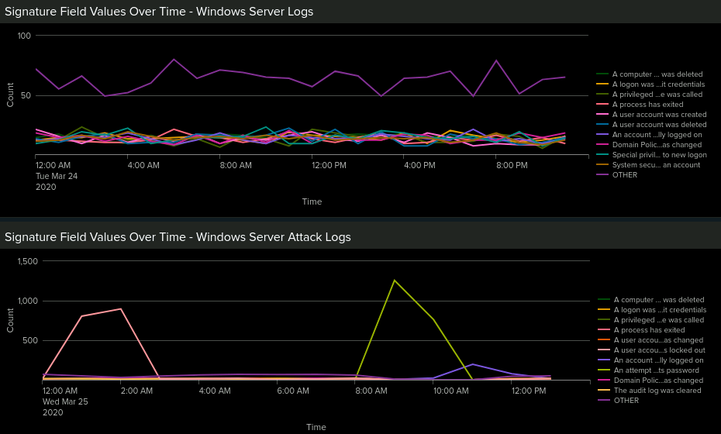
Dashboards—Attack Logs

Slide 37
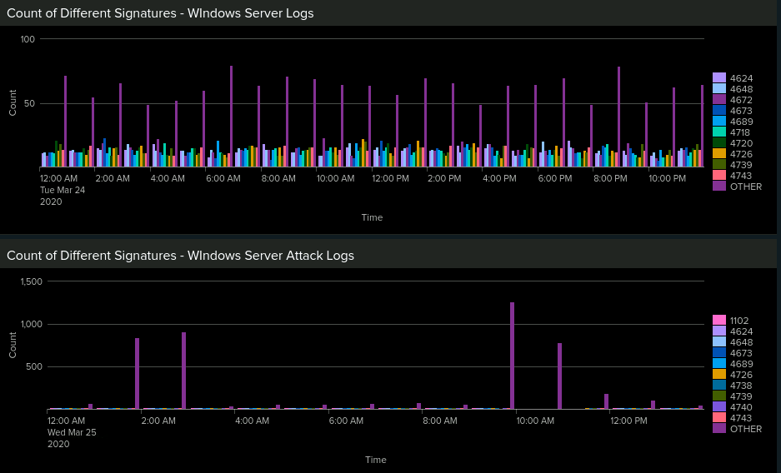
Dashboards—Attack Logs

Slide 38
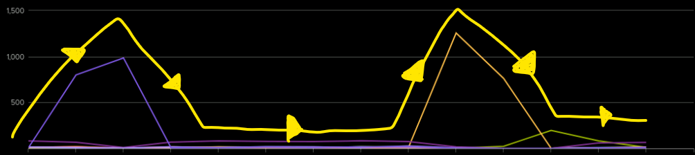
Attack Summary—Windows
There was a distinct correlation between the attack data points where two spikes in abnormal activity can be found.

Slide 39
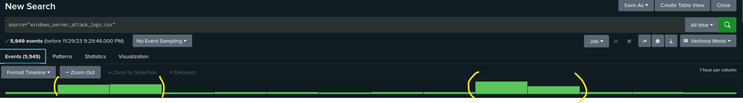
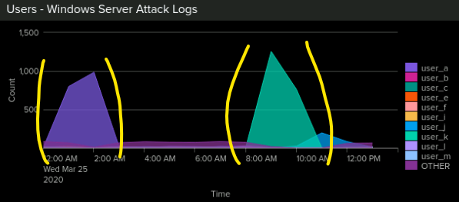
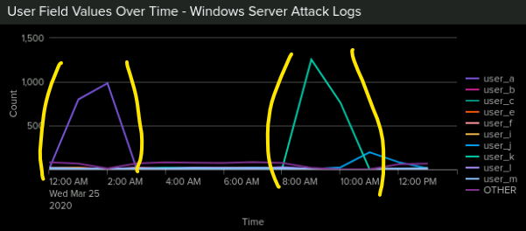
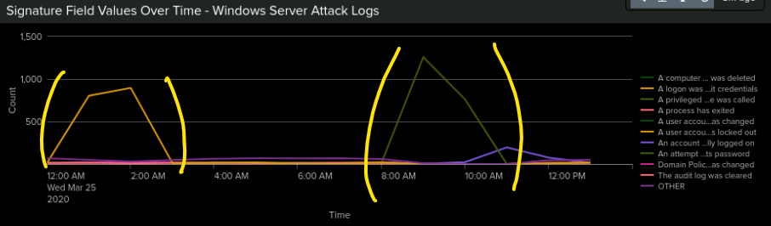
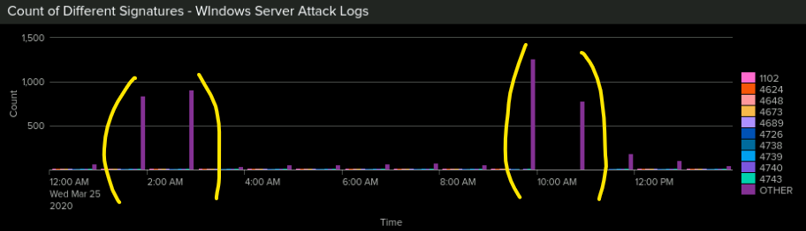
Screenshots of Attack Logs
Notes:
Summarize your findings from your dashboards when analyzing the attack logs.
We found that there were two users involved in suspicious activity based on the spikes in two signature IDs: (1) A user account was locked out, and (2) An attempt was made to reset an account’s password.
Displaying the logs in charts aids in our ability to easily spot abnormal activity - Correlation.

Slide 40
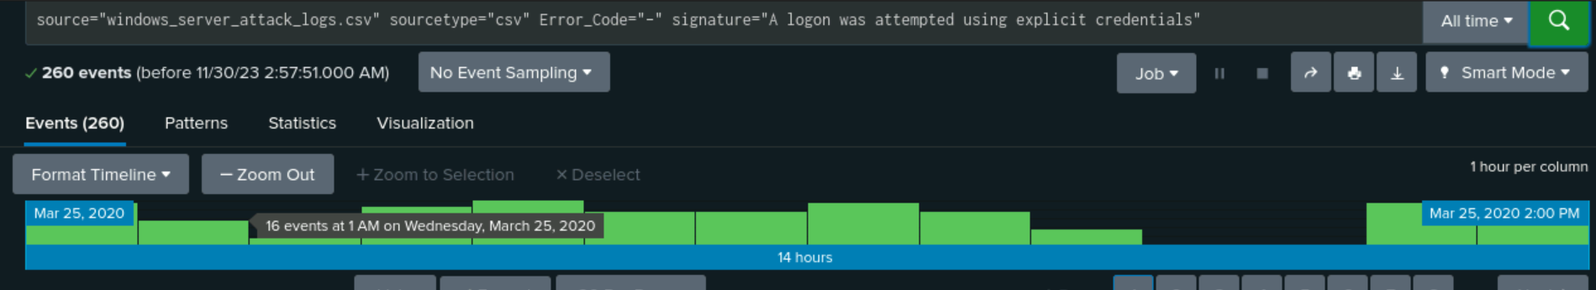
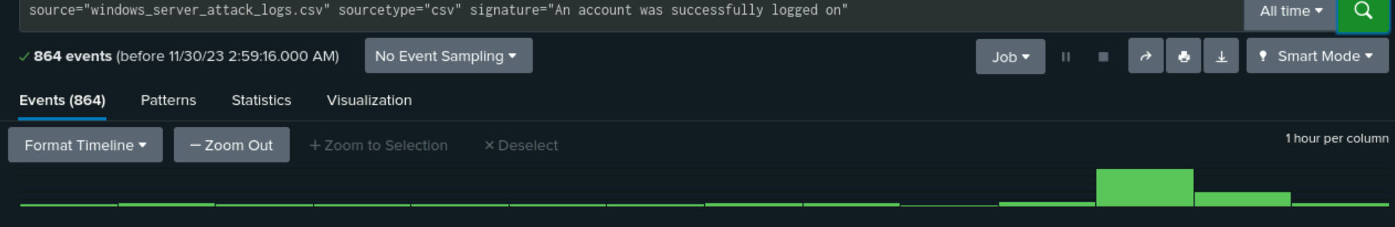
Attack Summary—Windows
Summarize your findings from your alerts when analyzing the attack logs. Were the thresholds correct?
Notes:
second photo, the lowest amount of login attempts was 8 followed by 46 the next hour.

Slide 41
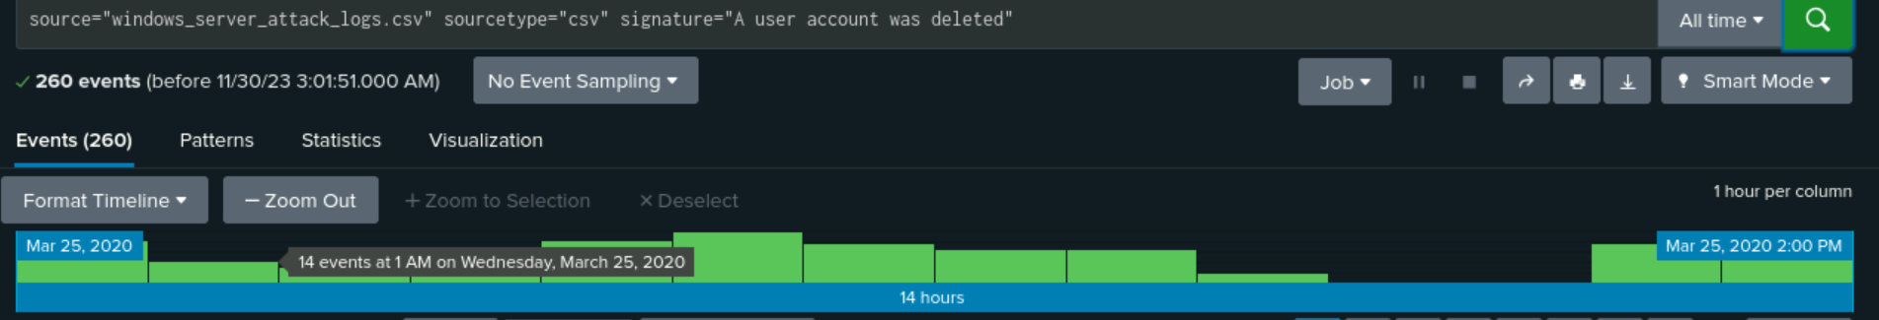
Attack Summary—Windows
Summarize your findings from your alerts when analyzing the attack logs. Were the thresholds correct?
Notes:
second photo, the lowest amount of login attempts was 8 followed by 46 the next hour.

Slide 42
Attack Summary—Apache
Summarize your findings from your reports when analyzing the attack logs.
The reports showed GET method activity decreased by 28.3% while POST method activity increased by 28.3%
There was no suspicious activity in referrer domains during the attack
The changes in HTTP response codes showed to be on the “404” code, which demonstrated an increase from 2% to 15%.

Slide 43
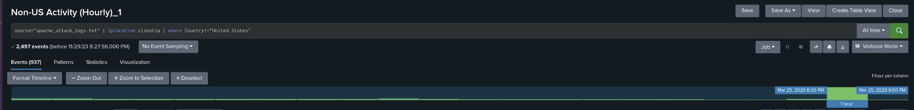
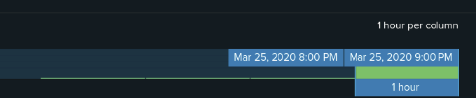
Attack Summary—Apache
Summarize your findings from your alerts when analyzing the attack logs. Were the thresholds correct?
Suspicious international activity was detected on Wednesday March 25, 2020 at 8:00PM in Ukraine
937 events
Since it is above the threshold, we would receive an alert. Threshold should stay the same.
Suspicious Volume of HTTP POST activity occurred March 25, 2020 at 8:00pm.
1,296 events
Threshold could stay the same or changes to 4 since most events ranged from 1-2.

Slide 44
Attack Summary—Apache
Summarize your findings from your dashboards when analyzing the attack logs.
Time Chart of HTTP Methods indicated suspicious activity:
GET activity increased to 729 events (5:00pm-7:00pm March 25, 2020)
POST activity increased to 1,296 events (7:00pm-9:00pm March 25, 2020)
Cluster Map revealed suspicious activity from cities such as Ukraine
The city of Kiev (440 counts)
The city of Kharkiv (432 counts)
URI data showed URI /VSI_Account_logon.php was hit the most with 1, 323 events
Indication of a brute force attack on the VSI login page

Slide 45
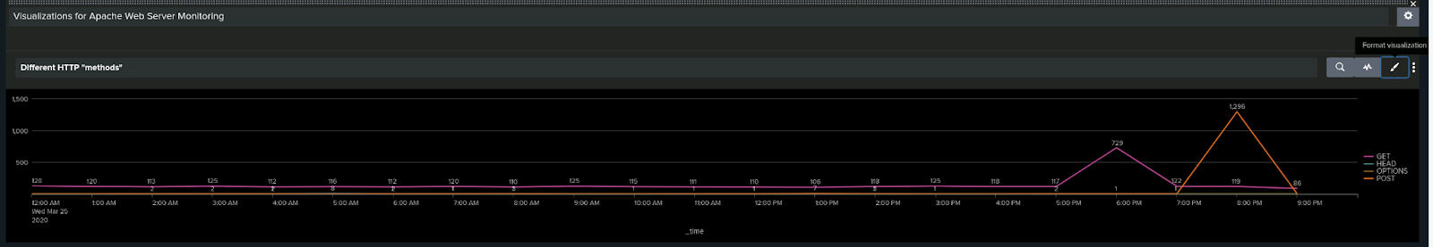
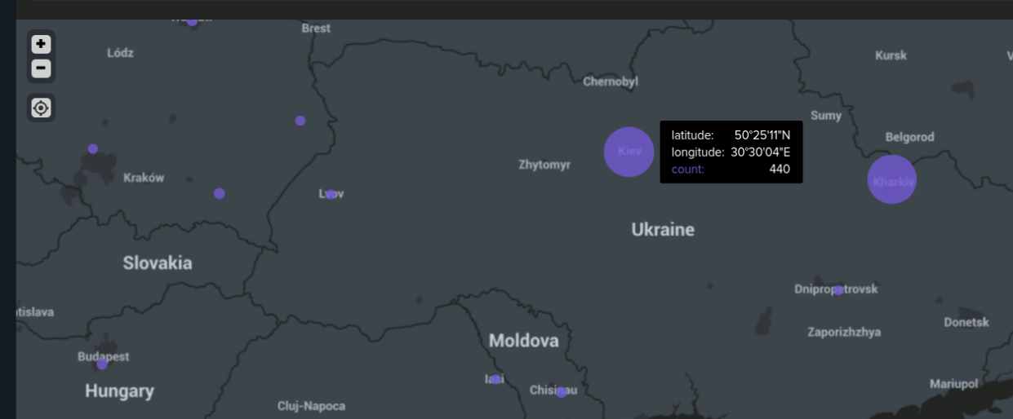
Screenshots of Attack Logs

Slide 46
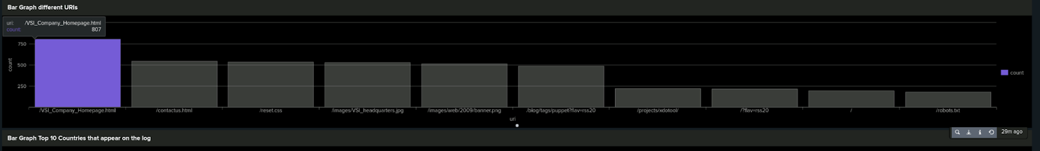
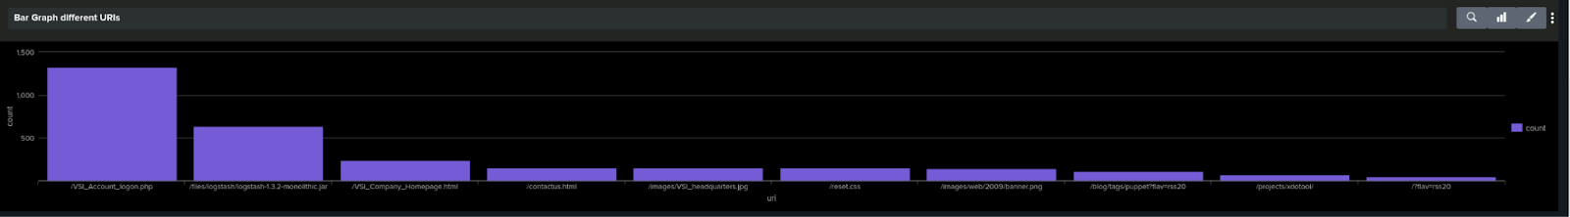
Screenshots of Attack Logs

Slide 47
Summary and Future Mitigations
‹#›

Slide 48
Project 3 Summary
What were your overall findings from the attack that took place?
Our overall findings showed that on March 25, 2020 VSI had multiple attacks on their Windows and Apache servers. The attacks appear to be Brute Force attacks and guessing passwords from different countries around the world.
To protect VSI from future attacks, what future mitigations would you recommend?
Using strong complex passwords, Two-Factor Authentication (2FA). Implementing CAPTCHA
Monitor user accounts and multiple failed login activity
Accounts locked (temporarily lock user accounts after certain amount of failed attempts)

